Slide 1

CSE101-Lec#21
Some other functions from string handling library

Slide 2
Outline
String Conversion Functions
Character arithmetic
Sorting of strings.

Slide 3
String Conversion Functions
The header file stdlib.h includes functions, used for different conversions.
When we get input of a different type other than the type of variable in which the value is being stored, it warrants the need to convert that type into another type.
These conversion functions take an argument of a type and return it after converting into another type.
Many times in C programs, expressions contain variables and constants of different data types. For calculation purposes, they need to be converted to the same data type. When you convert one data type into another, the method is termed type conversion

Slide 4
atof()
Function atof
Function atof converts its argument—a string to a floating point value.
Syntax:
atof(str);
The function returns the floating point value.
If the converted value cannot be represented—for example, if the first character of the string is a letter—the behavior of function atof is undefined.

Slide 5
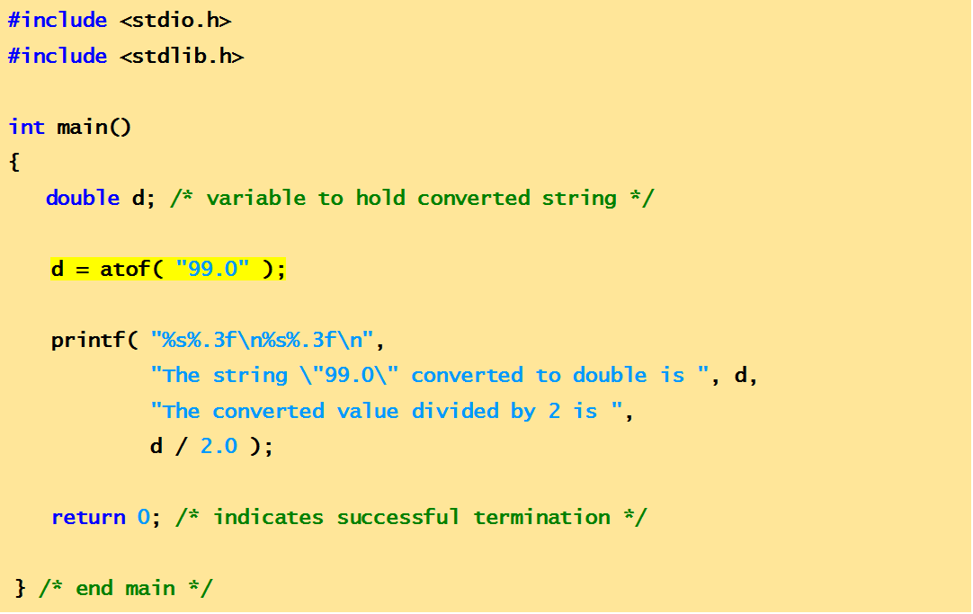
Example Code
This program demonstrates string conversion function: atof()
The string "99.0" converted to double is 99.000
The converted value divided by 2 is 49.500
output

Slide 6
atoi()
Function atoi
Function atoi converts its argument—a string— to an int value.
Syntax:
atoi(str);
The function returns the int value.
If the converted value cannot be represented, the behavior of function atoi is undefined.

Slide 7
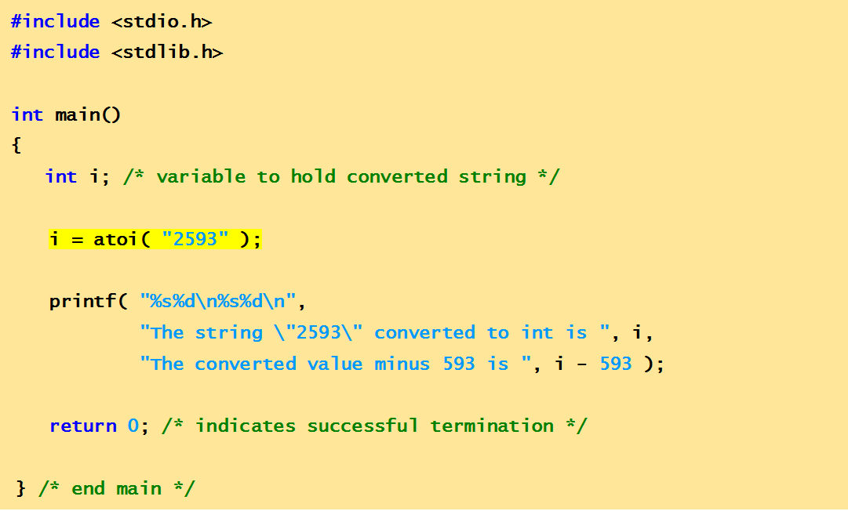
Example Code
This program demonstrates string conversion function: atoi()
The string "2593" converted to int is 2593
The converted value minus 593 is 2000
output

Slide 8
atol()
Function atol
Function atol converts its argument—a string— to a long value.
Syntax:
atol(str);
The function returns the long value.
If int and long are both stored in 4 bytes, function atoi and function atol work identically.

Slide 9
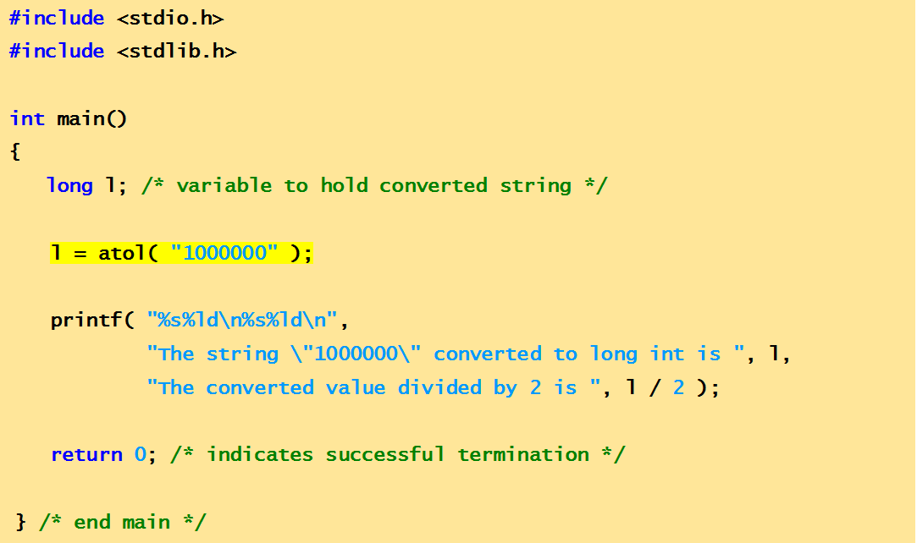
Example Code
This program demonstrates string conversion function: atol()
The string "1000000" converted to long int is 1000000
The converted value divided by 2 is 500000
output

Slide 10
itoa()
Converts an integer value to a null-terminated string using the specified base and stores the result in the array given by str parameter.
Syntax
itoa ( int value, char * str, int base );
where
value: Value to be converted to a string.
str: Array in memory where to store the resulting null-terminated string.
base: Numerical base used to represent the value as a string.

Slide 11
Character arithmetic
To perform increment , decrement, addition subtraction operations on the characters.
These operations work on the ASCII value of characters.
Starting from ASCII value of ‘a’ = 97 to the ASCII value of ‘z’ = 122

Slide 12
Increment
To display next char value
void main()
{
char x = 'a' + 1;
printf("%c", x); // Display Result = 'b‘
printf("%c", ++x); // Display Result = ‘c‘
}

Slide 13
Decrement
To display previous char value
void main()
{
char x = ‘b' - 1;
printf("%c", x); // Display Result = ‘a‘
}

Slide 14
Addition
Adding two ASCII values
void main()
{
char x = 'a‘ + ‘c’;
printf("%c", x); /* Display Result = - ( addition of ASCII of a and c is 196) */
}

Slide 15

Subtraction
Subtracting two ASCII values
void main()
{
char x = ‘z’ – ‘a’;
printf("%c",x); /* Display Result = ↓ (difference between ASCII of z and a ) */
}
Quick yak:
The friendship game can NOW be made more comprehensive based on ASCII values of characters in the First Names

Slide 16
Sorting of strings
To sort the strings in increasing order.
That is if list of names is given then sort the list in alphabetical order.
Use strcmp() and strcpy() functions.

Slide 17
#include<stdio.h>
#include<conio.h>
#include<string.h>
main()
{
char name[20][20];
char temp[20];
int i,j,n,l;
printf("Enter the no. of string to be sorted");
scanf("%d",&n);
printf(“Enter %d strings:\n", n);
for(i=0;i<=n;i++)
gets(name[i]);
for(i=0;i<=n;i++)
{
for(j=i+1;j<=n;j++)
{
l = strcmp(name[i], name[j]);
if(l>0) // if first string is greater then swap
{
strcpy(temp, name[i]);
strcpy(name[i],name[j]);
strcpy(name[j],temp);
}
}
}
puts("Sorted list is:\n");
for(i=0;i<=n;i++)
puts(name[i]);
getch();
}
Program to sort the strings using arrays.

Slide 18
Enter the no. of string to be sorted 3
Enter 3 strings
lovely
aananya
aman preet
Sorted list is:
aananya
aman preet
lovely

Slide 19
QUIZ

Slide 20
If the two strings are identical, then strcmp() function returns
A.-1
B.1
C.0
D.Yes

Slide 21
The library function used to find the last occurrence of a character in a string is
A.strnstr()
B.laststr()
C.strrchr()
D.strstr()

Slide 22
Which of the following function is used to find the first occurrence of a given string in another string?
A.strchr()
B.strrchr()
C.strstr()
D.strnset()

Slide 23
Which of the following function is more appropriate for reading in a multi-word string?
A.printf();
B.scanf();
C.gets();
D.puts();

Slide 24
What will be the output of the program ?
#include<stdio.h>
#include<string.h>
int main()
{
char str1[20] = "Hello", str2[20] = " World";
printf("%s\n", strcpy(str2, strcat(str1, str2)));
return 0;
}
A.Hello
B.World
C.Hello World
D.WorldHello

Slide 25
What will be the output of the program ?
#include<stdio.h>
#include<string.h>
int main()
{
printf("%d\n", strlen("123456"));
return 0;
}
A.6
B.12
C.7
D.2

Slide 26
What will be the output of the program ?
#include<stdio.h>
int main()
{
printf(5+"Good Morning\n");
return 0;
}
A.Good Morning
B.Good
C.M
D.Morning

Slide 27
What will be the output of the program ?
#include<stdio.h>
#include<string.h>
int main()
{
char str[] = "India\0\BIX\0";
printf("%s\n", str);
return 0;
}
A.BIX
B.India
C.India BIX
D.India\0BIX

Slide 28
What will be the output of the program ?
#include<stdio.h>
int main()
{
printf("India", "BIX\n");
return 0;
}
A.Error
B.India BIX
C.India
D.BIX

Slide 29
What will be the output of the program ?
#include<stdio.h>
int main()
{
char *names[] = { "Suresh", "Siva", "Sona", "Baiju", "Ritu"};
int i;
char *t;
t = names[3];
names[3] = names[4];
names[4] = t;
for(i=0; i<=4; i++)
printf("%s,", names[i]);
return 0;
}
A.Suresh, Siva, Sona, Baiju, Ritu
B.Suresh, Siva, Sona, Ritu, Baiju
C.Suresh, Siva, Baiju, Sona, Ritu
D.Suresh, Siva, Ritu, Sona, Baiju

Slide 30
What will be the output of the program ?
#include<stdio.h>
#include<string.h>
int main()
{
static char str1[] = "dills";
static char str2[20];
static char str3[] = "Daffo";
int i;
i = strcmp(strcat(str3, strcpy(str2, str1)), "Daffodills");
printf("%d\n", i);
return 0;
}
A.0
B.1
C.2
D.4

Slide 31
What will be the output of the program ?
#include<stdio.h>
int main()
{
int i;
char a[] = "\0";
if(printf("%s", a))
printf("The string is empty\n");
else
printf("The string is not empty\n");
return 0;
}
A.The string is empty
B.The string is not empty
C.No output
D.0

Slide 32
#include<stdio.h>
int main()
{
char str = "IndiaBIX";
printf("%s\n", str);
return 0;
}
A.Error
B.IndiaBIX
C.Base address of str
D.No output

Slide 33
What will be the output of the program?
#include<stdio.h>
#include<string.h>
int main()
{
char *str1 = "India";
char *str2 = "BIX";
char *str3;
str3 = strcat(str1, str2);
printf("%s %s\n", str3, str1);
return 0;
}
A.IndiaBIX India
B.IndiaBIX IndiaBIX
C.India India
D.Error

Slide 34
Which of the following statements are correct ?
1:A string is a collection of characters terminated by '\0'.
2:The format specifier %s is used to print a string.
3:The length of the string can be obtained by strlen().
4:The pointer CANNOT work on string.
A.1, 2
B.1, 2, 3
C.2, 4
D.3, 4

Slide 35
Which of the following statement is correct?
A.strcmp(s1, s2) returns a number less than 0 if s1>s2
B.strcmp(s1, s2) returns a number greater than 0 if s1<s2
C.strcmp(s1, s2) returns 0 if s1==s2
D.strcmp(s1, s2) returns 1 if s1==s2

Slide 36
Will the program compile successfully?
#include<stdio.h>
int main()
{
char a[] = "India";
char *p = "BIX";
a = "BIX";
p = "India";
printf("%s %s\n", a, p);
return 0;
}
A.Yes
B.No

Slide 37
For the following statements will arr[3] and ptr[3] fetch the same character?
char arr[] = "IndiaBIX";
char *ptr = "IndiaBIX";
A.Yes
B.No

Slide 38
Is there any difference between the two statements?
char *ch = "IndiaBIX";
char ch[] = "IndiaBIX";
A.Yes
B.No

Slide 39
What is the Output of the Following Program ?
#include<stdio.h>
#include<string.h>
int main()
{
char str[] = "Programming";
printf("%s ",&str[2]);
printf("%s ",str);
printf("%s ",&str);
return(0);
}
A. ogramming Programming Programming
B. ogramming Programming < Garbage Value >
C. Programming ogramming Programming
D. Program Compiled with Syntax Errors

Slide 40
Fill in the blanks:
"A" is a ___________ while ’A’ is a____________.
A string is terminated by a ______ character, which is written as ______.
The array char name[10]can consist of a maximum of ______ characters.
The array elements are always stored in _________ memory locations

Slide 41
Write a program that converts a string like "124" to an integer 124.

Slide 42
Next Lecture
Marking the attendance of students by passing attendance sheet …??
Pointer

